Slide 1
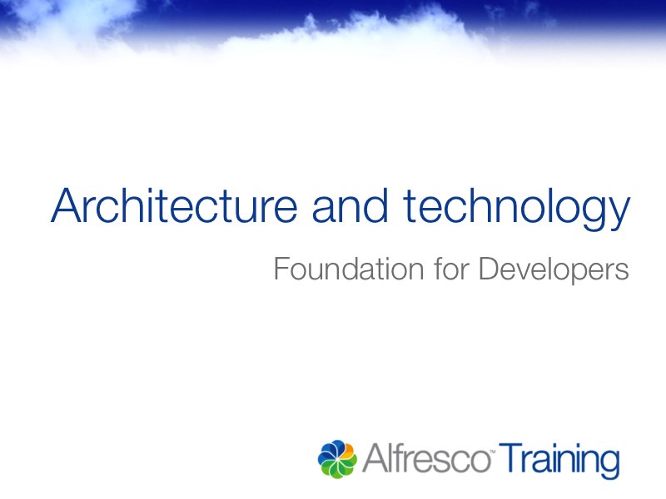

Slide 2

Where we are
Welcome | Repository configuration
Introducing Alfresco | Managing the repository
Architecture and technology | Content model overview
User interfaces | Creating content models
Users and groups | Developing applications
Permissions

Slide 3






Notes:
In this Alfresco Element the architecture and technology of the Alfresco Enterprise Content Management System is explored.

Slide 4

Client layer
Protocol and API connections
Repository layer
Storage layer
Database
File system
Notes:
The decisions which can and should be made regarding how to architect your installation are examined.

Slide 5
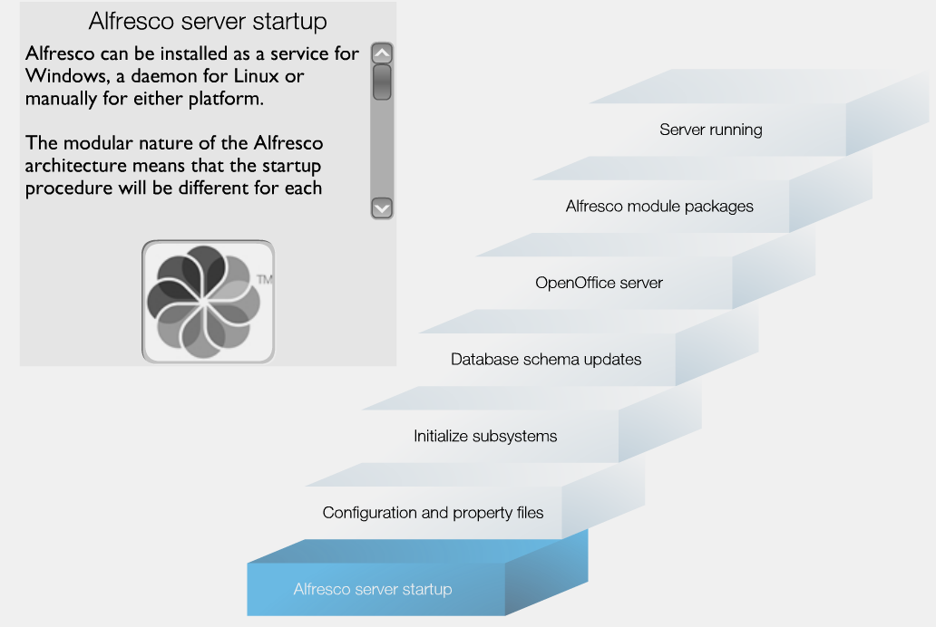
Notes:
The start-up process is reviewed, with particular reference to the order in which the components of the system initiate.

Slide 6

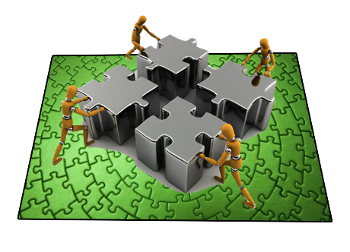
Operating
system
Database
Application
server
Hardware configurations
Notes:
The choice of operating system, database, application server and hardware configurations, which can be used for an Alfresco installation are examined.

Slide 7

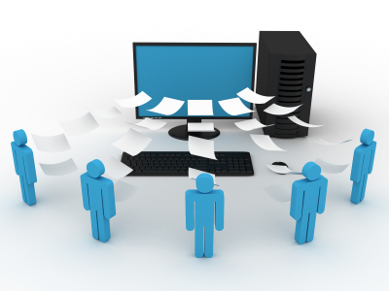


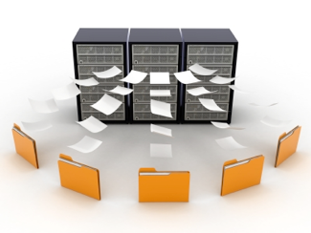

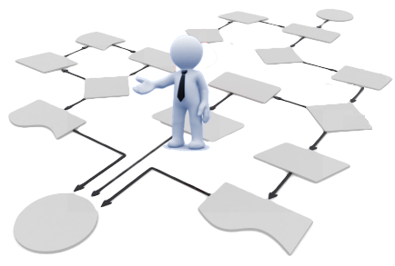
Document Management
Collaboration
Image Management
Records Management
Activiti Business
Process Management
Web Content Services
Notes:
Enterprise Content Management covers a broad range of applications. The Alfresco architecture is designed to support the requirements of these applications, resulting in a coherent solution where content and management processes are not forced into silos.
Alfresco recognizes that each discipline has unique but overlapping characteristics. The design of each Alfresco capability is not done in isolation but with consideration to the overall solution.

Slide 8
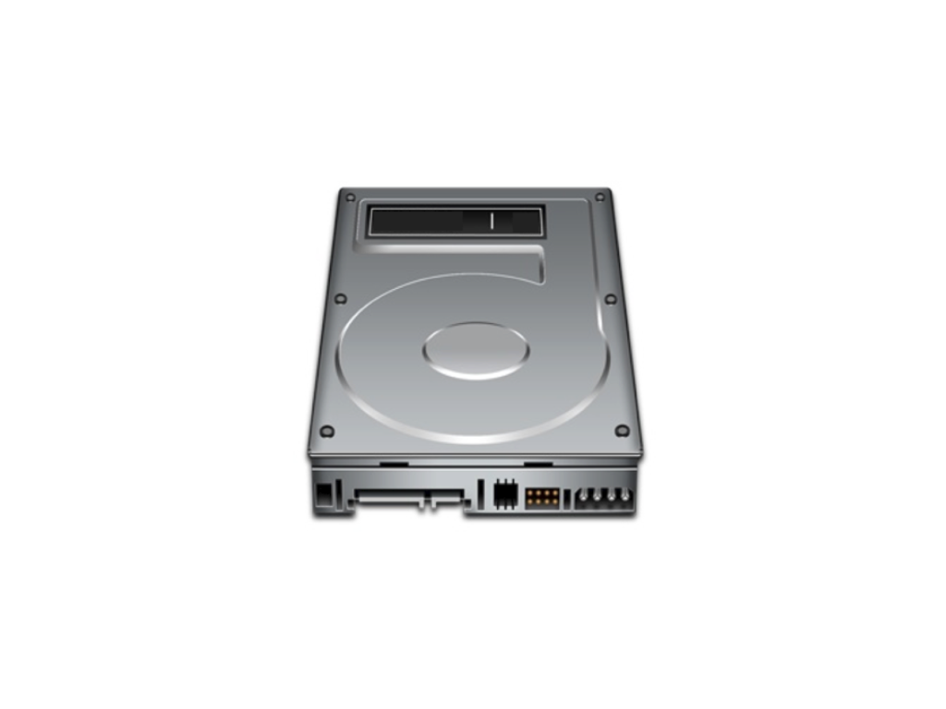
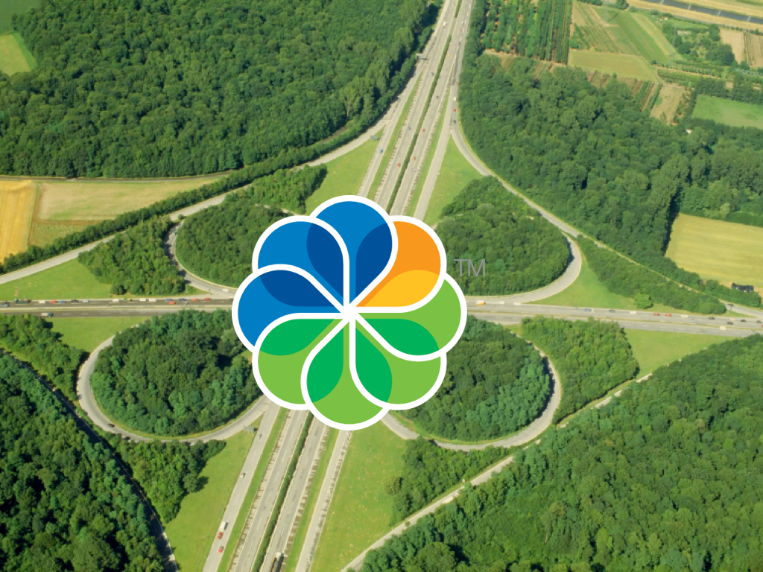



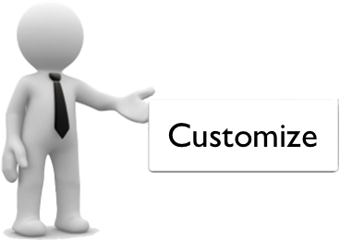
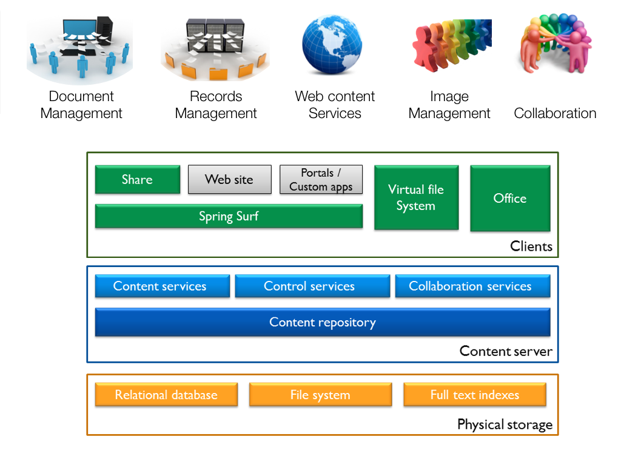
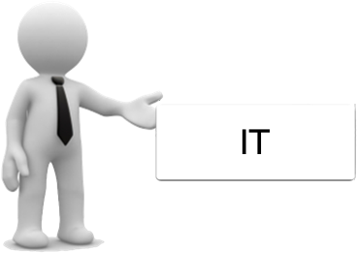
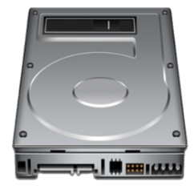
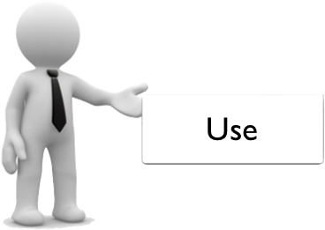
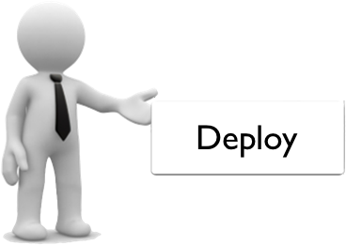
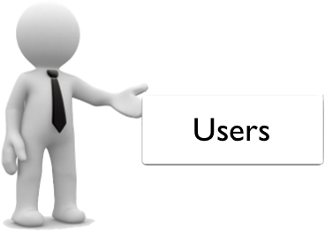
Notes:
Complexity of Enterprise Content Management systems is often a barrier to entry. Many deployments do not reach their full potential due to restrictions enforced on developers, IT and users of the system.
Alfresco is driven to deliver a system which is simple to develop against, customize, deploy and to use.
The shared document drive is the most commonly used application for Enterprise Content Management systems. Alfresco can present itself as a shared drive and this is the simplest and easiest user interface which users can access. It is one of many different interfaces which the Alfresco architecture has been engineered to deliver.

Slide 9

Client layer
Protocol and API connections
Repository layer
Storage layer
Database
File system
Notes:
The Alfresco architecture can be thought of in three layers. The storage layer is where the actual data and content is stored. This is managed by the repository layer. Because the two layers are separate they can be run on independent hardware to increase performance and to provide resilience.
The repository layer provides a multitude of protocols and APIs through which client applications can connect. When you install Alfresco various client applications are provided by default. Some organizations will develop their own bespoke applications or integrate existing applications with Alfresco to provide document and content services.
As for the storage and repository layers the client layer can also be deployed to a distinct physical environment.

Slide 10



Notes:
Since the Alfresco architecture is abstracted by layers, flexibility of system deployment is introduced. This is the mechanism through which scaling and clustering can be implemented, thereby affording support for vast volumes of content and large numbers of system users.

Slide 11

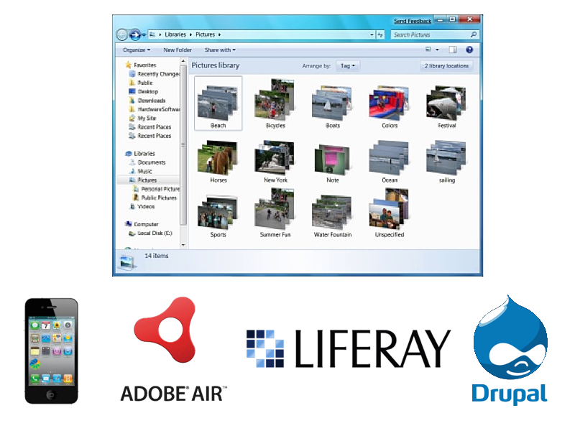

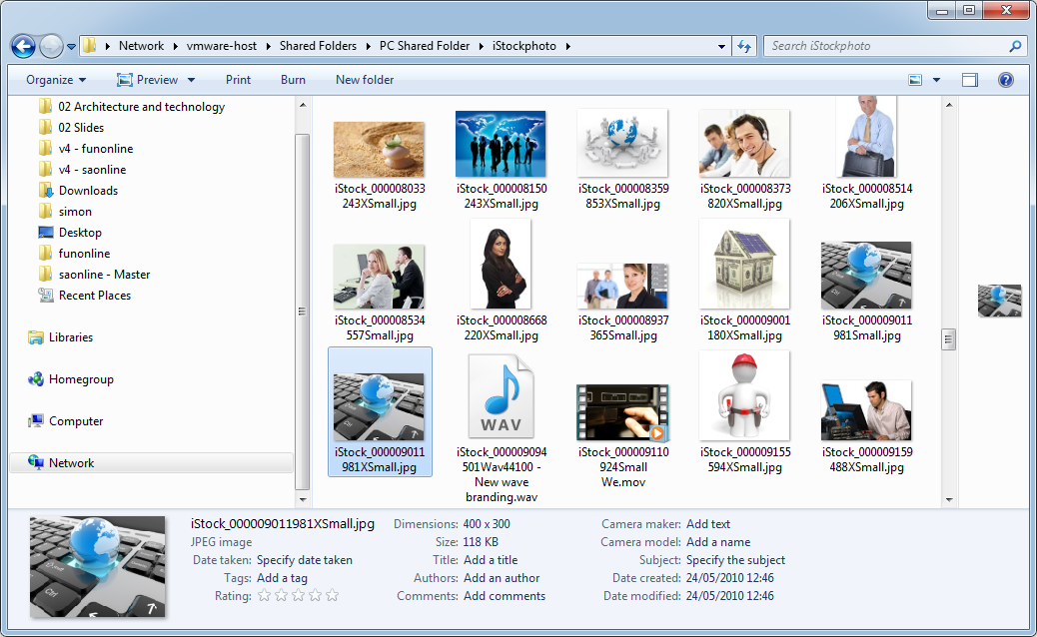



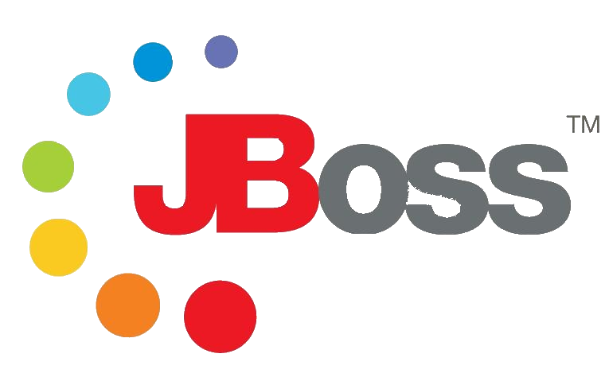



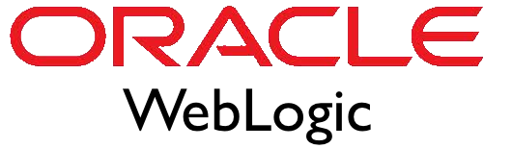
Notes:
Enterprise Content Management often refers to services embedded within an end-user application.
The Alfresco Enterprise Content Management system is written in one hundred percent Java. This is a trusted runtime for many enterprises wishing to deploy applications in their data centers. Each Alfresco capability is implemented as a black-box Java service that is tested independently and tuned appropriately.
As you have seen there are a range of application servers which can be used for Alfresco and you will be familiar with how your particular application server is implemented and structured.
If you purchase any Alfresco Element (where there is lab work) you will see we have chosen to use the Tomcat application server within the supplied virtual machine.

Slide 12
Technology agnostic
Operating
system
Database
Application
server
Web browser
Authentication system
3rd party integrations and components
Notes:
Enterprise Content Management often forms part of a larger solution. The Alfresco architecture is engineered so it can be deployed to a range of operation systems, databases, application servers, browsers and authentication systems. Alfresco does not dictate this choice, but certifies the system for use within a large number of tested technology stacks and 3rd party integrations.

Slide 13
Repository layer
Content server
Content services
Control services
Collaboration services
Content repository
Content
storage
Query
Versioning
Transformation
Notes:
The repository layer is often referred to as the content server. It stores content of all types and provides a set of re-usable content management services such as content storage, query, versioning and transformation which may be used by one or more applications.
Control services enable workflow, records management and changes sets.
Collaboration services provide functionality such as wikis, blogs, discussion forums and social media functionality.

Slide 14


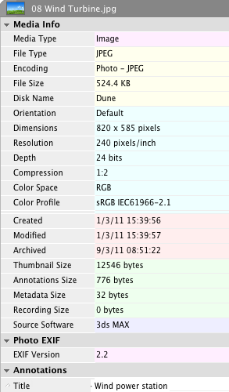

Notes:
Content files are constructed in two parts. The first component is metadata (often described as data about data). This contains information such as the creation date, modification date, keywords, annotations and a host of additional describing detail. The content itself is stored in the secondary component and this is the representation the user sees within an editing or viewing application.

Slide 15
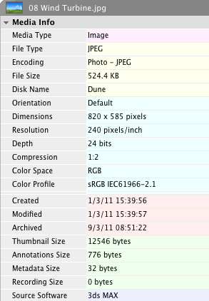

Metadata
Content
Storage layer
Relational database
File system
Full text indexes
Notes:
Alfresco utilizes this file structure when managing content.
The metadata is extracted and stored in the database, thereby delivering a range of functionality which can be undertaken against this data.
The content is stored within the file system. Placing it within the file system (rather than in the database as some system do) delivers maximum performance when accessing, retrieving and working with the content.
In order to support user searching and queries Alfresco indexes the content within a full text indexing system.

Slide 16

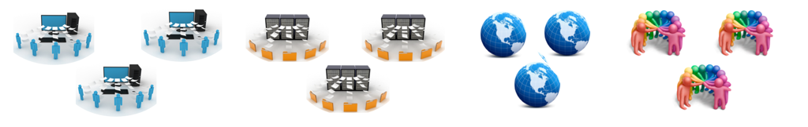
Clients
Share
Web site
Portals /
Custom apps
Virtual file System
Office
Spring Surf
Content server
Content services
Control services
Collaboration services
Content repository
Physical storage
Relational database
File system
Full text indexes
Notes:
There are many ways to deploy Alfresco, using some or all of the solution components.
Each component typically splits functionality across a client and server, where clients offer users and interface to the solution and the server provides content management services and storage.
It is common for a solution to offer multiple clients against a shared server, where each client is tailored for the environment in which it is to be used.

Slide 17

Alfresco server startup

Slide 18

Notes:
Having explored the startup process by component, let’s look in greater detail.
In this example Alfresco has been installed manually. The alfresco.sh command is used to initiate the server. This checks if the database to be used with Alfresco is running. In this instance it’s not, and Postgres is launched.
The Tomcat web application server is next started.
The alfresco.sh script ends as tomcat is now launching.
The alfresco.log file records the actions and errors of the Alfresco server and we could examine this, however I tail the tomcat log file catalina.out since this shows the same detail with some additional information I wish to highlight.
The tomcat server reads the web.xml file and then a number of other Spring configuration and property files which define and control the Alfresco startup.
The first of the sub systems is started, in this instance the ‘sysAdmin’ subsystem. Many others will be launched at various points in the process.
The system checks if any database schema changes are required for the Alfresco database.
A connection to the rendering and transformation service, OpenOffice, is attempted. The service is not presently available.
Next checks for any AMP files or patches to be applied are made. These would be written to the alfresco.war file (which contains the application), prior to that file being expanded and deployed.
Illustrating the asynchronous nature of the startup process a number of other subsytems are initiated. These include, file systems, email, Google Docs, and others.
Apache Solr is next started.
A second attempt to connect to the OpenOffice server succeeds now that service is running.
Alfresco Share is deployed and expanded from the share.war file.
Web Scripts are registered and deployed. Web Scripts are an enabling and extensible technology, core functionality of Alfresco is written in Web Scripts.
The Alfresco server is now fully launched and available.

Slide 19
Clients
Share
Web site
Portals /
Custom apps
Virtual file System
Office
Spring Surf
Content server
Content services
Control services
Collaboration services
Content repository
Physical storage
Relational database
File system
Full text indexes
Notes:
When you are planning out your Alfresco installation there are some key architecture decisions which you will make, these relate principally to where you place different components of the system. The location of components can have a dramatic effect on the performance and reliability of the system, so it is important to get this right.
There are decisions about which you have no choice over and there are some general rules which you can use to ensure that you get a good and solid architecture.

Slide 20
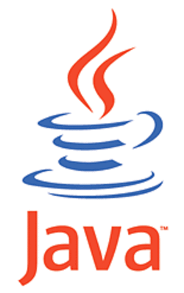
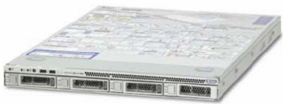
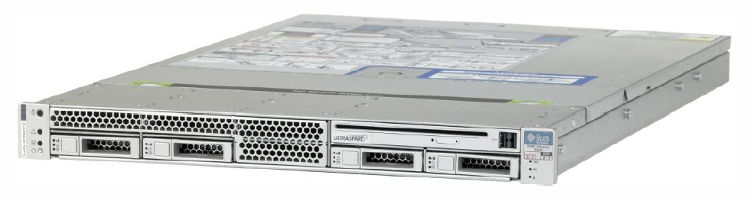

Fibre channel
Server
server
SAN
Application server
Gigabit ethernet
Application server
Lan
Wan
Content server
Fiber
channel
Content server
Database server
Database server
File system
Full text index
File system
Full text indexes
Server class hardware.
Use a 64 bit operating system.
Server
server
server
With SCSI raid disk arrays.
Server
server
Java Virtual Machine limited to 2 gigabytes on a 32 bit operating system.
Consider using SAN infrastructure.
Notes:
Whilst for development purposes you may often run all the components of Alfresco on a single system, for production it is best practice to deploy your database and the content server on different machines. This gives you greater flexibility when configuring the hardware and tuning the system's independently.
This configuration should be treated as the minimum configuration for production. Obviously your real configuration will vary depending on the application for which you are using Alfresco. For example if you are using Alfresco for Image Management and therefore doing scanning you will need other servers to host the scanning software.
The flexibility in the Alfresco architecture affords the possibility of moving the front end application server to one or more servers; allowing for improved performance, load balancing and redundancy.
There are some hardware and software considerations you should take into account when building your production Alfresco infrastructure. Firstly with respect to hardware you should use server class machines with SCSI Raid disk arrays. The performance of reading and writing content is almost solely dependent on the speed of your network and the speed of your disk infrastructure, the overhead of the Alfresco content server itself for reading and writing content is very low. So SCSI should be considered the entry level configuration, you should seriously consider using a SAN infrastructure for enterprise scale performance.
In some cases it may be tempting to make the file system remote and mount onto the content server machine across a LAN or WAN, this is not advised and will cause performance problems. The file system should always be attached to the content server through a high-speed connection such as fibre channel.
As you have seen the operating system must be 64bit since the size of a Java Virtual Machine is restricted to 2GB on a 32bit operating system. This will not support the requirements of a production Alfresco deployment.

Slide 21




Scalability
Languages
Performance
Indexing granularity
v3
Content server
Eventually consistent
Solr
Full text indexes
File system
Notes:
Alfresco version 4 introduced a change in architecture for indexing and user search; Apache Solr is now the default full text indexing technology. Lucene was used prior to this and can be enabled in favour of Solr if required.
Solr embeds and leverages Lucene, however Solr provides a functionally abstracted layer and can be installed on a dedicated server.
Solr delivers a number of advantages over Lucene including scalability, improved performance, enhanced language support and fine control over what gets indexed.
A principle issue for Lucene is transactional dependence; the indexes are updated as content is loaded or edited. This delivers fully accurate and synchronised indexes, but means the content server is locked during the transaction. This is a particular problem if the indexes ever have to be rebuilt from scratch, an operation that can take many hours with large content repositories.
The drawback and consideration when using Solr, is that it works asynchronously and is known as “eventually consistent”. Content is indexed at small regular intervals and until the indexes are up to date.

Slide 22

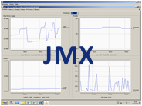

Content server
Content services
Control services
Collaboration services
Content repository
Content repository
Subsystem
Subsystem
Subsystem
Subsystem
Subsystem
Subsystem
Subsystem
Subsystem
Kerberos
OpenLDAP
Oracle directory server
IMAP bindings
Authentication
[options]
Notes:
Let’s examine the content server and the architecture of the content repository.
The content repository is comprised of a number of subsystems. These are configurable modules responsible for a sub-part of Alfresco functionality. Typically, a subsystem wraps an optional functional area, such as IMAP bindings, or one with several alternative implementations, such as authentication.
As a unit, subsystems have their own lifecycle and they may be shut down and restarted while the Alfresco server is running. This is useful if you wish to disable an aspect of the server, or reconfigure parts of it, for instance how LDAP synchronization is mapped.
Each subsystem supports its own administration interface that is accessible through the administrator’s console of Alfresco Share, within property files, or directly through a management console using Java Management Extensions (JMX ).
Subsystems are implemented so that there may be multiple instances of the same type where this makes sense. For example there may be more than one way of facilitating authentication.
Within the ‘Managing the Repository’ Alfresco Element you have the opportunity to configure and manipulate subsystems.

Slide 23

Not all directories
are shown
Alfresco installation
directory
alf_data
Default
content directory
amps
Alfresco
module packages
bin
Scripts and
.jar files
openoffice
Transformation
and rendering
postgresql
Default database
tomcat
Web
application server
bin
Scripts and
.jar files
conf
.xml files
for Tomcat
logs
Tomcat log files
shared
Shared classes and
configuration files
webapps
Web applications
alfresco
Alfresco
application
share
Alfresco Share
application
solr
Full text indexes
Notes:
This diagram depicts an Alfresco installation. This is the file structure as created by the installer.
In production systems it is unlikely you would use the installer to deploy Alfresco, components are typically installed manually, for example directly to the web application server. Additionally remember that individual components can be split out to their own tier or server and therefore this is only a general representation.
When you have finished exploring the diagram, click Continue.
This concludes the architecture and technology review of Alfresco.

Slide 24
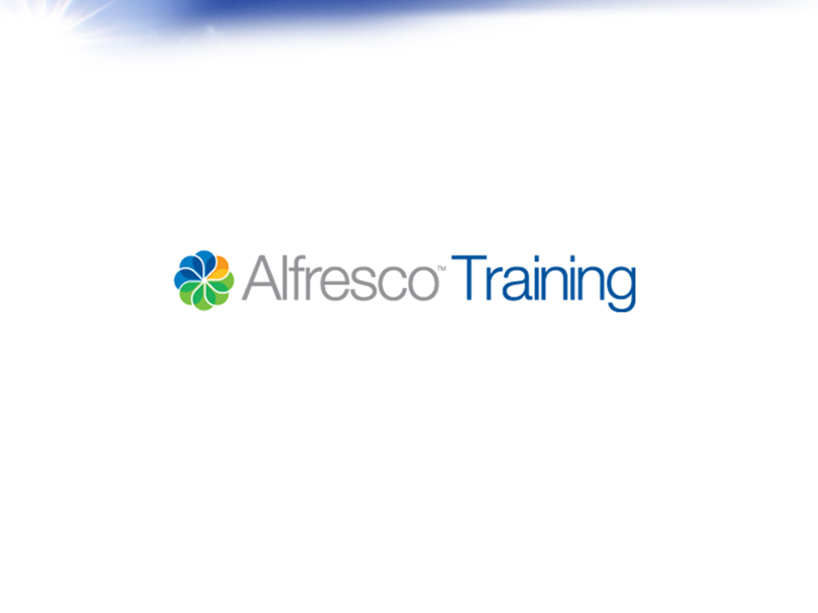
© Alfresco Software 2013

